Slide 1

Accessing and Manipulating
Databases
By
Y.Cherishma
Cse-D

Slide 2
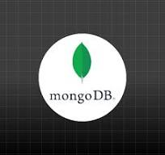
Connecting to a MongoDB Database
1
Installation
Install MongoDB on your local machine or a cloud platform.
2
Driver Selection
Choose a compatible driver for your programming language, like Python, Java, or Node.js.
3
Establish Connection
Connect to your database using your credentials and the selected driver.

Slide 3
Creating and Inserting Documents
2
Create Collection
1
Create Database
Collections are analogous to tables in relational databases.
Use the `use` command to create or switch to a specific database.
3
Insert Document
Insert a JSON-like document into the collection using the `insertOne` or `insertMany` methods.

Slide 4

Querying and Retrieving Data
find()
Returns all documents in a collection.
findOne()
Returns the first document matching the criteria.
countDocuments()
Returns the number of documents matching the criteria.
aggregate()
Allows complex data transformations and aggregation operations.

Slide 5
Updating and Modifying Documents
updateOne
updateMany
Modify a single document based on specific criteria.
Modify multiple documents matching the criteria.
replaceOne
upsert
Replace an existing document with a new one.
Insert a new document if it doesn't exist, otherwise update it.

Slide 6
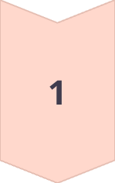
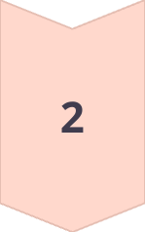
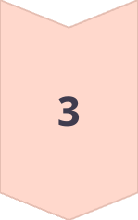
Deleting Documents
deleteOne
Removes a single document based on the criteria.
deleteMany
Removes multiple documents matching the criteria.
dropCollection
Deletes all documents and the collection itself.

Slide 7
Conclusion
MongoDB is a versatile and powerful NoSQL database that offers excellent performance and scalability for handling unstructured data. Its flexible data model, querying capabilities, and robust tools make it a popular choice for a wide range of applications.MongoDB's ease of integration with both the frontend and backend, combined with its powerful querying, makes it an ideal choice for building fast, dynamic, and scalable applications. Whether it's handling simple CRUD operations or powering real-time apps, MongoDB offers the tools and performance necessary to meet the demands of modern, data-intensive applications.

Slide 8
THANK YOU

